Slide 1
Lab 1: Arduino Basics
Topics: Arduino Fundamentals, First Circuit
Date: Aug 26, 2016

Slide 2
References (study these)
https://www.arduino.cc/en/Guide/Introduction
https://www.arduino.cc/en/Tutorial/Foundations
https://www.arduino.cc/en/Guide/BoardAnatomy
https://www.arduino.cc/en/Tutorial/DigitalPins
https://www.arduino.cc/en/Tutorial/AnalogInputPins
https://www.arduino.cc/en/Tutorial/PWM
https://www.arduino.cc/en/Tutorial/Memory
https://www.arduino.cc/en/Reference/PinMode
https://www.arduino.cc/en/Reference/DigitalWrite
https://www.arduino.cc/en/Reference/DigitalRead
https://www.arduino.cc/en/Reference/AnalogRead
https://www.arduino.cc/en/Reference/AnalogWrite
https://www.arduino.cc/en/ArduinoStarterKit/Prj02

Slide 3
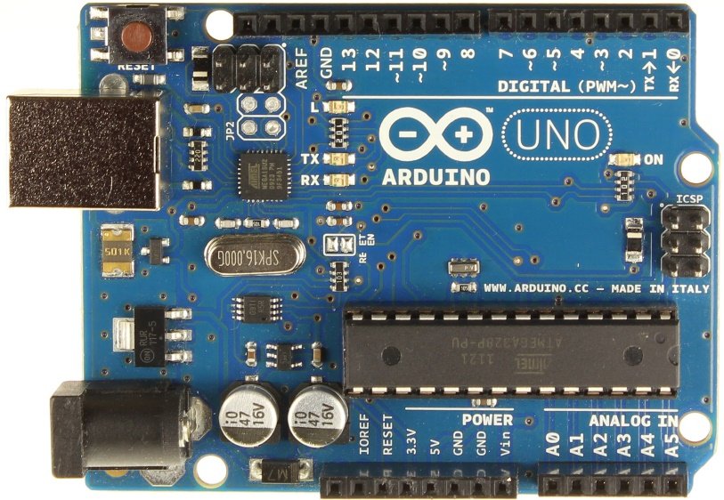
What is Arduino?
“Open-source prototyping platform based on easy to use HW and SW.”
Inexpensive
Cross-platform
Simple programming environment (IDE)
Open-source SW and HW

Slide 4
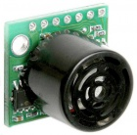
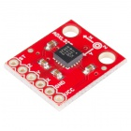
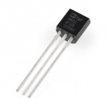
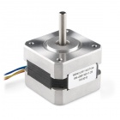
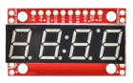
Making Stuffs using Arduino
You can connect sensors and actuators, and program your Arduino to control them.
Sensors (input)
Actuators (output)

Slide 5
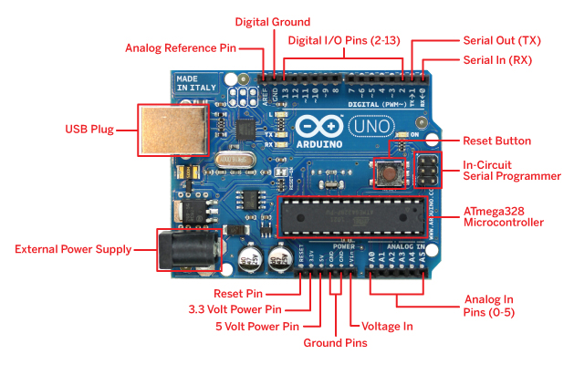
Arduino Uno Anatomy
http://arduinoarts.com/tag/anatomy/

Slide 6
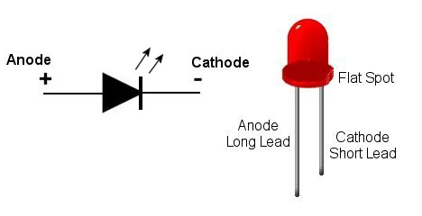
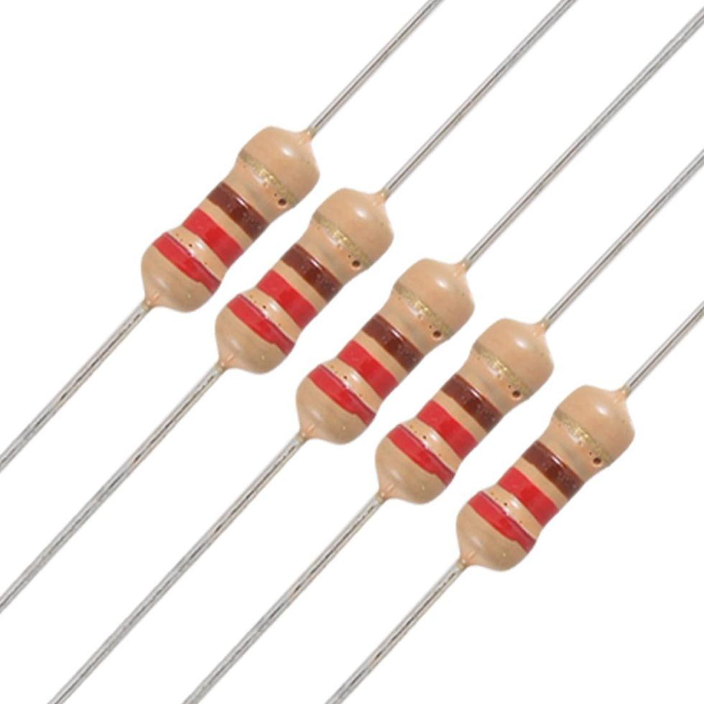
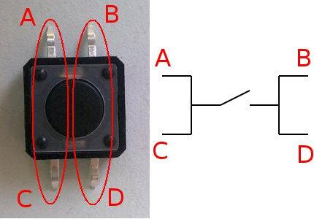
Know Your Tools
(all images are from Google image search)

Slide 7
Program Structure
setup() – executed once at the beginning.
loop() – it’s an infinite loop.

Slide 8
Arduino Language Reference
Almost the same as C with some new things:
setup() and loop()
Constants: HIGH, LOW, INPUT, OUTPUT
PROGMEM, EEPROM
Digital/Analog input/output functions
Library methods for – character, bits, interrupts, and communication.
https://www.arduino.cc/en/Reference/HomePage

Slide 9
Digital Read and Write
Digital IO: HIGH or LOW
int ledPin = 13; // LED connected to digital pin 13
int inPin = 7; // pushbutton connected to digital pin 7
int val = 0; // variable to store the read value
void setup()
{
pinMode(inPin, INPUT); // sets digital pin 7 as input
pinMode(ledPin, OUTPUT); // sets digital pin 13 as output
}
void loop()
{
val = digitalRead(inPin); // read the input pin (button)
digitalWrite(ledPin, val); // sets the LED to the value
}

Slide 10
Analog Read
Arduino UNO has a 10-bit analog-to-digital converter, so input voltage mapped to [0, 1023]
int analogPin = 3;
// potentiometer middle terminal connected to analog pin 3 outside leads to ground and +5V
int val = 0; // variable to store the value read
void setup()
{
Serial.begin(9600); // setup serial
}
void loop()
{
val = analogRead(analogPin); // read the input pin
Serial.println(val); // debug value
}

Slide 11
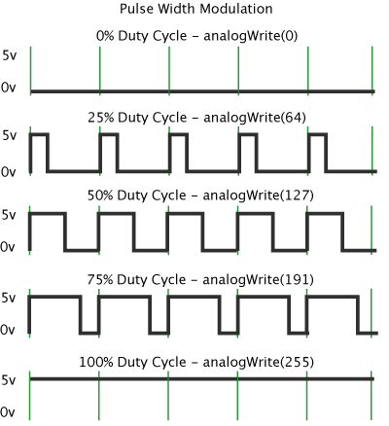
Analog Write (PWM)
Getting analog results with digital means.
Must be [0, 255], and it will mean “duty cycle”.
pinMode(9, OUTPUT);
int X = 123;
analogWrite(9, X);

Slide 12
Memory
TYPE | SIZE (UNO) | USE | Volatile?
Flash | 32K | Program space | No
SRAM | 2K | Variables | Yes
EEPROM | 1K | Long term information | No
Optimizing SRAM use:
Use a connected smartphone/computer to move data out for calculation.
Use smaller data types (byte if you don’t need an int.)
Use Flash memory (PROGMEM keyword)
Use EEPROM (use EEPROM library)

Slide 13
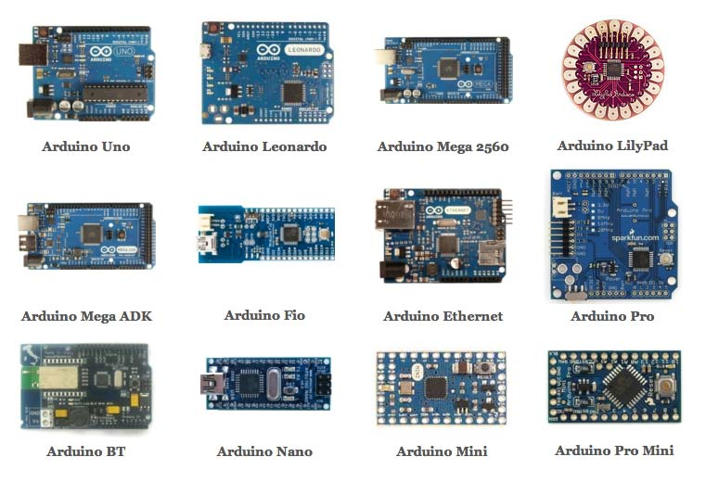
Variety of Arduino Boards

Slide 14
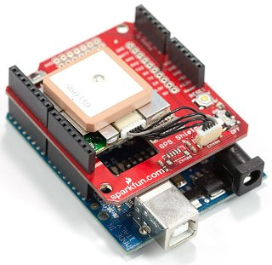
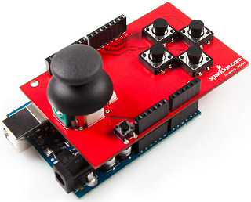
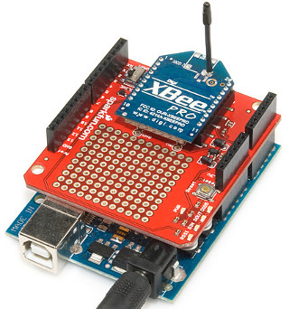
Expanding Arduino with ‘Shields’
Arduino + GPS Shield
Arduino + Joy Stick Shield
Arduino + Xbee Shield

Slide 15
Lab Work: “Spaceship Interface”
It’s project #2 of Arduino Projects Book.
https://www.arduino.cc/en/ArduinoStarterKit/Prj02
Once you are done, please take an extra 5 minutes to put all electronic elements back into the box.

