Slide 1
Lab 2: Arduino Sensors
Topics: Arduino Sensor Reading, Display
Date: Sept 2, 2016

Slide 2
References (study these)
https://www.arduino.cc/en/Tutorial/HelloWorld
http://www.allaboutcircuits.com/projects/interface-an-lcd-with-an-arduino/
https://www.arduino.cc/en/tutorial/potentiometer
https://learn.sparkfun.com/tutorials/sik-experiment-guide-for-arduino---v32/experiment-7-reading-a-temperature-sensor

Slide 3
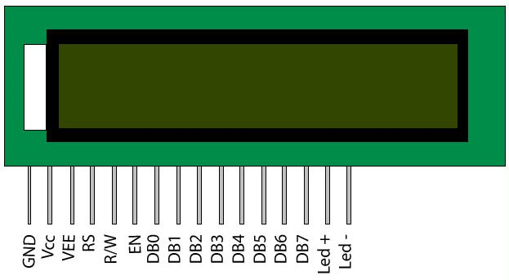
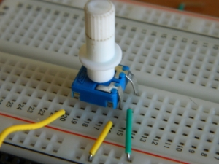
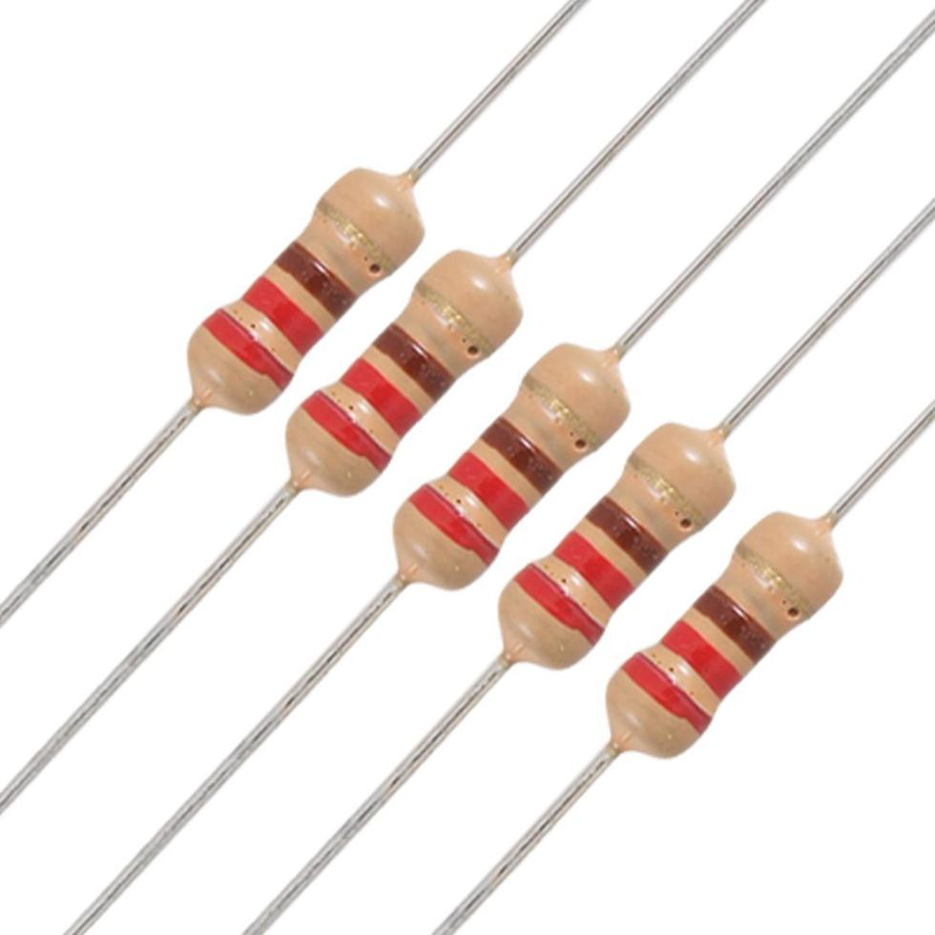
LCD Display – HW Setup
It has 16 pins: 12 of them need to be connected to {Vcc, GND, potentiometer, and Arduino pins}
1 | 2 | 3 | 4 | 5
VSS/GND | VCC/+5 | V0/ POT | RS/ Pin 12 | RW/ GND
6 | 7-10 | 11-14 | 15 | 16
E/ Pin11 |  | D4-D7/ Pin2-Pin5 | LED+/ Res+VCC | LED-/ GND
Potentiometer
Resistor

Slide 4
LCD Display – Programming
Include the library and initialize.
lcd.begin(COLS, ROWS); lcd.setCursor(COL, ROW); lcd.print(“string”); lcd.print(FP_Num, 4);
#include <LiquidCrystal.h> // initialize the library with the numbers of the interface pins LiquidCrystal lcd(12, 11, 5, 4, 3, 2); void setup() { // set up number of columns and rows: lcd.begin(16, 2); // Print a message to the LCD. lcd.print("hello, world!"); } void loop() { // set the cursor to column 0, line 1 lcd.setCursor(0, 1); // print the number of sec since reset: lcd.print(millis() / 1000); }

Slide 5
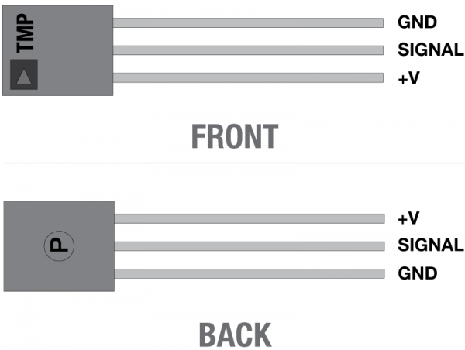
Temperature Sensor
It has 3 pins.
The middle one gives you sensor value [0, 1023]
How do you map the value to voltage?
Temp (C) = (Voltage – 0.5) * 100
How do you get Temp (F)?
val = analogRead(AnalogPin);

Slide 6
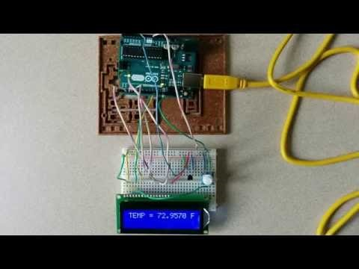
Lab 2 – Read and Display Temperature

